Slide 1

Hospital Appointment Data Pipeline
Team No. :- 12
2420030014 :- V.Sanjay Bhaargav
2420030368 :- P.Rahul
2420030573 :- M.Aasrith
Under the Guidance of :-
Dr.N.Shirisha,Associate Professor
Department of Computer Science

Slide 2
Abstract
The Hospital Appointment Data Pipeline is a data-driven solution designed to organize, process, and analyse hospital appointment records. The system collects appointment data from structured sources such as CSV and JSON files and processes it through an ETL pipeline using Python and Pandas. The data is cleaned, transformed, and standardized to handle duplicate, missing, and inconsistent values. The processed data is stored in a NoSQL MongoDB database for efficient storage and retrieval. MongoDB queries are used to analyze appointment statistics and identify patient, department-wise, doctor-wise, and monthly appointment patterns. A Streamlit dashboard provides interactive reports and visualizations of appointment metrics and trends. The proposed system demonstrates the fundamental stages of data engineering, from data ingestion and cleaning to transformation, storage, and analysis.

Slide 3
Introduction
Hospital appointments are an important part of healthcare service management. Appointment records are often maintained across different systems or files, making data cleaning, storage, and analysis difficult. Raw appointment records may contain missing or duplicate entries and can be time-consuming to process. There is a need for a simple data-driven system that can collect, process, and analyze appointment data. Our project uses Data Engineering techniques to transform raw appointment data into meaningful insights. The system helps monitor appointment patterns, identify cancellations and no-shows, and support efficient hospital record management.

Slide 4
Existing & Proposed System
1. Existing System
Manual Tracking: Many hospitals still record appointments in registers or spreadsheets.
Fragmented Tools: Basic systems support booking/cancelling only, with little analytical reporting.
2. Limitations of Existing System
No Automated Cleaning: Duplicate and missing records are corrected manually — slow and error-prone.
No Pattern Analysis: Department-wise, doctor-wise, and no-show trends are rarely exposed.
3. Proposed System
Automated ETL Pipeline: Python and Pandas clean and transform raw CSV/JSON appointment records.
NoSQL Storage & Analytics: MongoDB stores the data; a Streamlit dashboard surfaces status and trends.
4. Advantages of Proposed System
Reduced Manual Effort: Automated cleaning removes repetitive, manual corrections.
Actionable & Extensible: Staff get visual reports, and new data sources can be added easily.

Slide 5
Objectives
To collect hospital appointment data from structured sources such as CSV or Excel files.
To clean and transform raw appointment data using Python.
To remove duplicate records and handle missing or inconsistent values.
To store the processed data in a structured NoSQL database.
To analyze appointment patterns using SQL queries.
To identify completed, cancelled, and no-show appointments.
To generate useful reports and visualizations for hospital staff and administrators.

Slide 6
Literature Survey
No. | Paper Title & Year | Authors | Drawbacks / Limitations | What It Contributes to Our Project | Link
1 | Outpatient Scheduling in Health Care: A Review of Literature – 2003 | Cayirli & Veral | Reviews many scheduling models, but most solutions are situation-specific and do not provide a practical data-processing pipeline. | Helps identify important appointment factors such as waiting time, demand, capacity and scheduling patterns that our cleaned appointment data can be used to analyze. | https://doi.org/10.1111/j.1937-5956.2003.tb00218.x
2 | The Effectiveness of Outpatient Appointment Reminder Systems in Reducing No-Show Rates – 2010 | Parikh et al. | Focuses mainly on reminder interventions and does not implement an automated data engineering workflow. | Shows the importance of tracking appointment status, waiting time and patient attendance, which our pipeline organizes for analysis. | https://doi.org/10.1016/j.amjmed.2009.11.022
3 | Methods and Dimensions of Electronic Health Record Data Quality Assessment – 2013 | Weiskopf & Weng | Focuses on EHR data-quality assessment rather than appointment-specific ETL processing. | Provides data-quality concepts such as completeness, correctness, concordance, plausibility and currency, supporting our cleaning and validation stage. | https://doi.org/10.1136/amiajnl-2011-000681
4 | Outpatient Appointment Systems in Healthcare: A Review of Optimization Studies – 2017 | Ahmadi-Javid, Jalali & Klassen | Concentrates on optimization and decision-support models rather than implementation of a complete data pipeline. | Helps identify strategic, tactical and operational appointment factors that can be derived from our processed hospital records. | https://doi.org/10.1016/j.ejor.2016.06.064
5 | No-shows in Appointment Scheduling – A Systematic Literature Review – 2018 | Dantas et al. | Reviews factors influencing no-shows but does not provide a reusable ETL/database solution for hospital appointment data. | Supports analysis of no-show patterns, lead time and previous appointment behavior using structured appointment records. | https://doi.org/10.1016/j.healthpol.2018.02.002

Slide 7
Literature Survey
No. | Paper Title & Year | Authors | Drawbacks / Limitations | What It Contributes to Our Project | Link
6 | Patient No-Show Prediction: A Systematic Literature Review – 2020 | Zapata et al. | Concentrates mainly on predictive modelling; data preparation and pipeline design are secondary aspects of the study. | Supports the need for structured appointment data, status-based analysis and properly prepared features before applying prediction techniques. | https://doi.org/10.3390/e22060675
7 | A Harmonized Data Quality Assessment Terminology and Framework for the Secondary Use of EHR Data – 2016 | Kahn et al. | Provides a general framework and requires adaptation to specific appointment datasets and workflows. | Provides a systematic basis for checking data completeness, conformance, plausibility and quality during our ETL process. | https://doi.org/10.13063/2327-9214.1244
8 | ETL Processes for Integrating Healthcare Data – Tools and Architecture Patterns – 2022 | Cheng et al. | Compares healthcare ETL tools and architecture patterns; the examples are broader than hospital appointment analytics. | Directly supports our Data Ingestion → Transformation → Storage architecture for processing healthcare appointment data. | https://doi.org/10.3233/SHTI220974
9 | No-Show in Medical Appointments with Machine Learning Techniques: A Systematic Literature Review – 2022 | Salazar et al. | Focuses primarily on machine-learning-based no-show prediction; practical integration with hospital data systems remains limited. | Identifies useful appointment attributes such as patient age, previous no-shows and lead time, which can be derived from our cleaned dataset. | https://doi.org/10.3390/info13110507
10 | Predicting Patient No-Shows Using Machine Learning: A Comprehensive Review and Future Research Agenda – 2025 | Toffaha et al. | Reviews machine-learning research and highlights gaps in data collection, preprocessing and real-world implementation. | Reinforces the importance of reliable data preparation, temporal features and implementation-ready datasets for future predictive analytics. | https://doi.org/10.1016/j.ibmed.2025.100229

Slide 8
Problem Gap Identification
1. Data Quality Gap
Inconsistent Records: Duplicate and missing entries are common across raw CSV/JSON appointment files.
No Central Pipeline: There is no automated flow connecting raw files to a clean, query-ready database.
2. Analytics Gap
No Trend Visibility: Existing hospital tools rarely expose department-wise or doctor-wise appointment patterns.
No No-Show Insight: Cancelled and no-show appointments are not tracked or analyzed systematically.
3. Scalability Gap
Manual Effort: Cleaning and reporting by hand does not scale as appointment volume grows.
Rigid Storage: Fixed-schema relational systems struggle with varied or evolving record formats.
4. How This Project Addresses It
Automated Pipeline: Cleans and standardizes data end-to-end instead of manual correction.
Flexible Analytics: NoSQL storage and a dashboard expose status and trend patterns directly.

Slide 9
Innovation, Creativity, and Novelty
1. Automated Data Engineering Pipeline
End-to-End Automation: Ingestion, cleaning, transformation, and storage run as one repeatable pipeline.
Feature Engineering: Automatically derives useful fields such as appointment lead time from raw bookings.
2. NoSQL-First Design
Flexible Schema: MongoDB collections embed related data for faster access than rigid relational tables.
Status Indexing: Completed/Cancelled/No-Show fields are indexed for fast filtering and reporting.
3. Interactive Analytics Dashboard
Streamlit Visualization: Turns raw records into interactive charts for status and department-wise trends.
Built for Staff: Designed for hospital staff and administrators, not just technical users.
4. Practical, Extensible Approach
Real-World Data Style: Built and tested on realistic, messy appointment data rather than clean samples.
Room to Grow: The modular design allows new data sources or predictive features to be added later.

Slide 10
Feasibility and Project Plan
1. Technical Feasibility
Proven Stack: Python, Pandas, MongoDB, and Streamlit are mature, well-documented, and free to use.
Team Skillset: The team has hands-on experience with Python scripting and NoSQL databases.
2. Data Feasibility
Available Formats: Hospital appointment data in CSV/JSON form is realistic and easy to source or simulate.
Manageable Scale: Dataset size suits a single-machine pipeline without specialized infrastructure.
3. Operational Feasibility
Low Setup Cost: All tools used are open-source, needing no paid licenses or dedicated servers.
Clear Ownership: Each pipeline stage — ingest, clean, store, visualize — is a distinct, testable module.
4. Project Plan
Phase-wise Delivery: Ingestion and cleaning were built first, then MongoDB storage, then the dashboard.
On Track for Review 3: Core pipeline and dashboard are functional, with refinement and testing ongoing.

Slide 11
Requirements
1. Software Requirements
Languages & Libraries: Python, Pandas, PyMongo, Streamlit, and Plotly/Matplotlib.
Database & Tools: MongoDB, VS Code / Jupyter Notebook, and Git for version control.
2. Hardware Requirements
Development Machine: A standard laptop/PC (multi-core CPU, 8GB+ RAM) is sufficient for this dataset.
Storage: A local or cloud-hosted MongoDB instance for storing processed collections.
3. Functional Requirements
Core Operations: Ingest, clean, store, and visualize hospital appointment data end-to-end.
Status Handling: Correctly classify appointments as Completed, Cancelled, or No-Show.
4. Non-Functional Requirements
Performance: Queries and dashboard updates should return results without noticeable delay.
Usability: Reports and charts should be understandable to non-technical hospital staff.

Slide 12
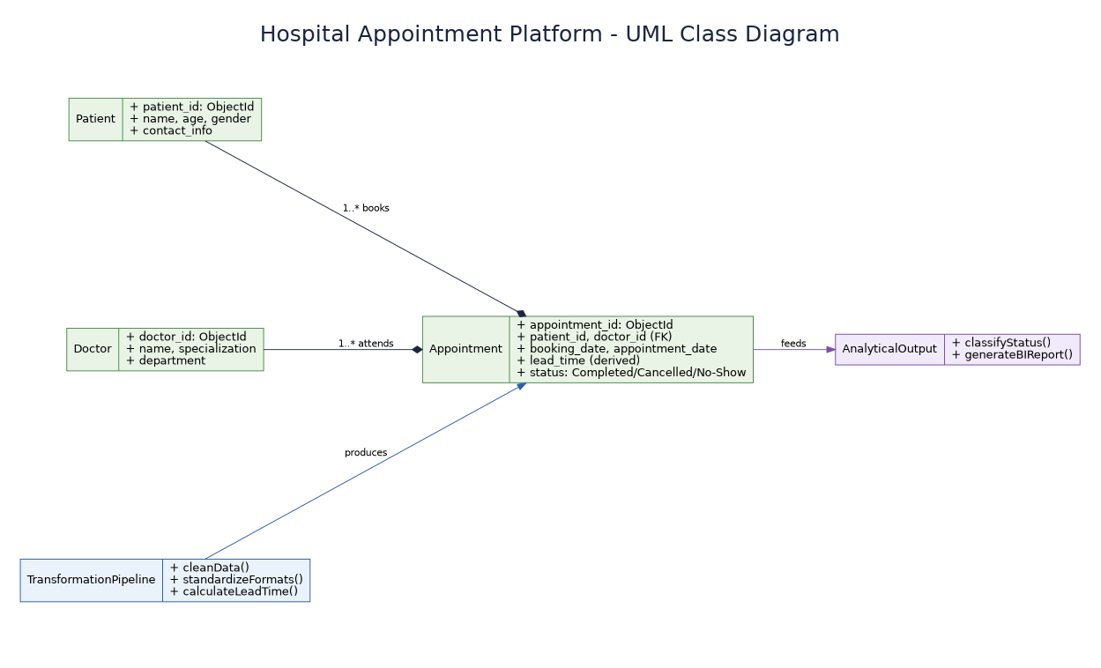

Slide 13
Hospital Appointment Data Pipeline Architecture
1. Data Ingestion Layer (Raw Inputs)
Source Data: Raw, unorganized hospital files (CSV/JSON format)
Contents: Messy records of appointment bookings, patient details, and doctor schedules
2. Data Transformation Layer (The Processing Engine)
Data Cleaning: Python/SQL scripts automatically drop duplicate records and handle missing (null) values
Standardisation: Converts conflicting date/time formats into a single, uniform standard
Feature Engineering: Automatically calculates the Lead Time (days between booking date and appointment date)
3. Storage Layer (The Clean Database)
Structured Storage: Cleaned data is saved into a NoSQL database (MongoDB) instead of a relational store
Schema Design: Data is organized into collections — Patients, Doctors, and Appointments — instead of relational tables, using embedded/document structures for fast, flexible querying (e.g., a Patient document can embed their recent appointment history directly, reducing joins)
4. Analytical Output Layer (The Final View)
Status Classification: Organizes records into indexed status fields — Completed, Cancelled, No-Show (MongoDB supports single-field and compound indexes on these directly within documents)
Business Intelligence Ready: Delivers clean, structured datasets ready for tracking monthly trends, department vacancies, and doctor cancellation rates

Slide 14
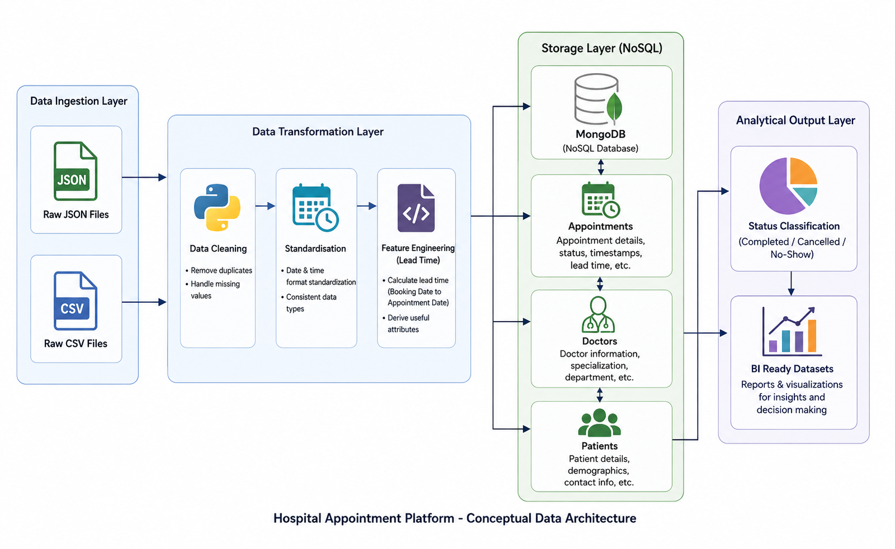

Slide 15
Modules and Implementation
1. Data Ingestion Module
Function: Reads raw appointment records from CSV/JSON files using Python and Pandas.
Validation: Checks file structure and loads records into memory for further processing.
2. Data Cleaning & Transformation Module
Cleaning: Uses Pandas functions such as drop_duplicates and fillna to remove duplicate records and handle missing values.
Standardisation: Converts inconsistent date/time formats into a single uniform standard and computes appointment lead time.
3. Storage Module
Connection: Uses PyMongo to connect the pipeline to MongoDB and write cleaned records into the database.
Schema: Organizes data into Patients, Doctors, and Appointments collections with indexes on status fields for faster queries.
4. Analytics & Dashboard Module
Aggregation: Runs MongoDB queries to compute department-wise, doctor-wise, and monthly appointment statistics.
Visualization: Displays the results as interactive charts and tables through a Streamlit dashboard.

Slide 16
Tools and Technologies Used
1. Programming & Data Processing
Python: Core language used to build the ETL pipeline and data-processing logic.
Pandas: Cleans, transforms, and standardizes raw appointment records.
2. Database
MongoDB: NoSQL database used to store Patients, Doctors, and Appointments as documents.
PyMongo: Python driver used to connect the pipeline to the MongoDB database.
3. Visualization & Dashboard
Streamlit: Builds the interactive web dashboard used for appointment analytics.
Plotly / Matplotlib: Generates charts for status, department-wise, and monthly trend visualizations.
4. Development Environment
VS Code / Jupyter Notebook: Used to write and test the pipeline scripts.
Git: Used for version control and collaboration among team members.

Slide 17
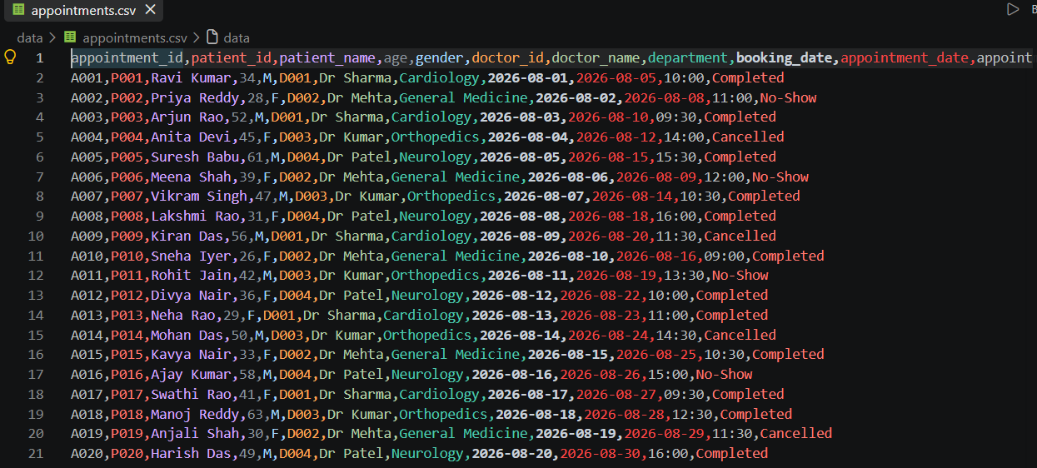
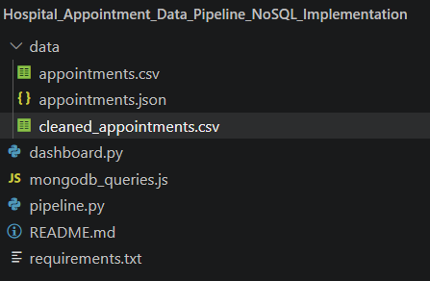
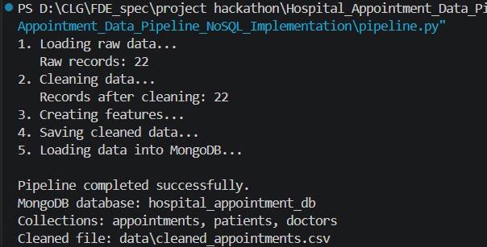
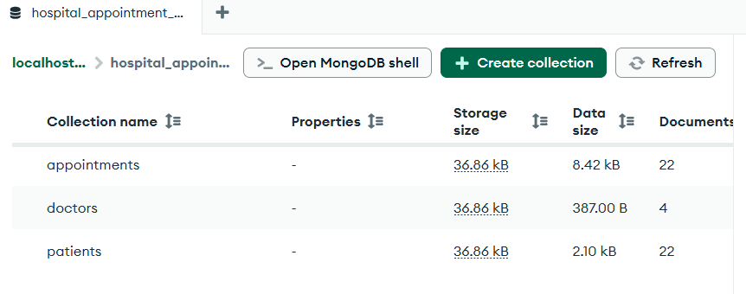
Figure 1: Project Structure and Source Files
Figure 2: Raw Hospital Appointment Dataset
Figure 3: Successful Execution of Data Processing Pipeline
Figure 4: Processed Data Stored in MongoDB

Slide 18
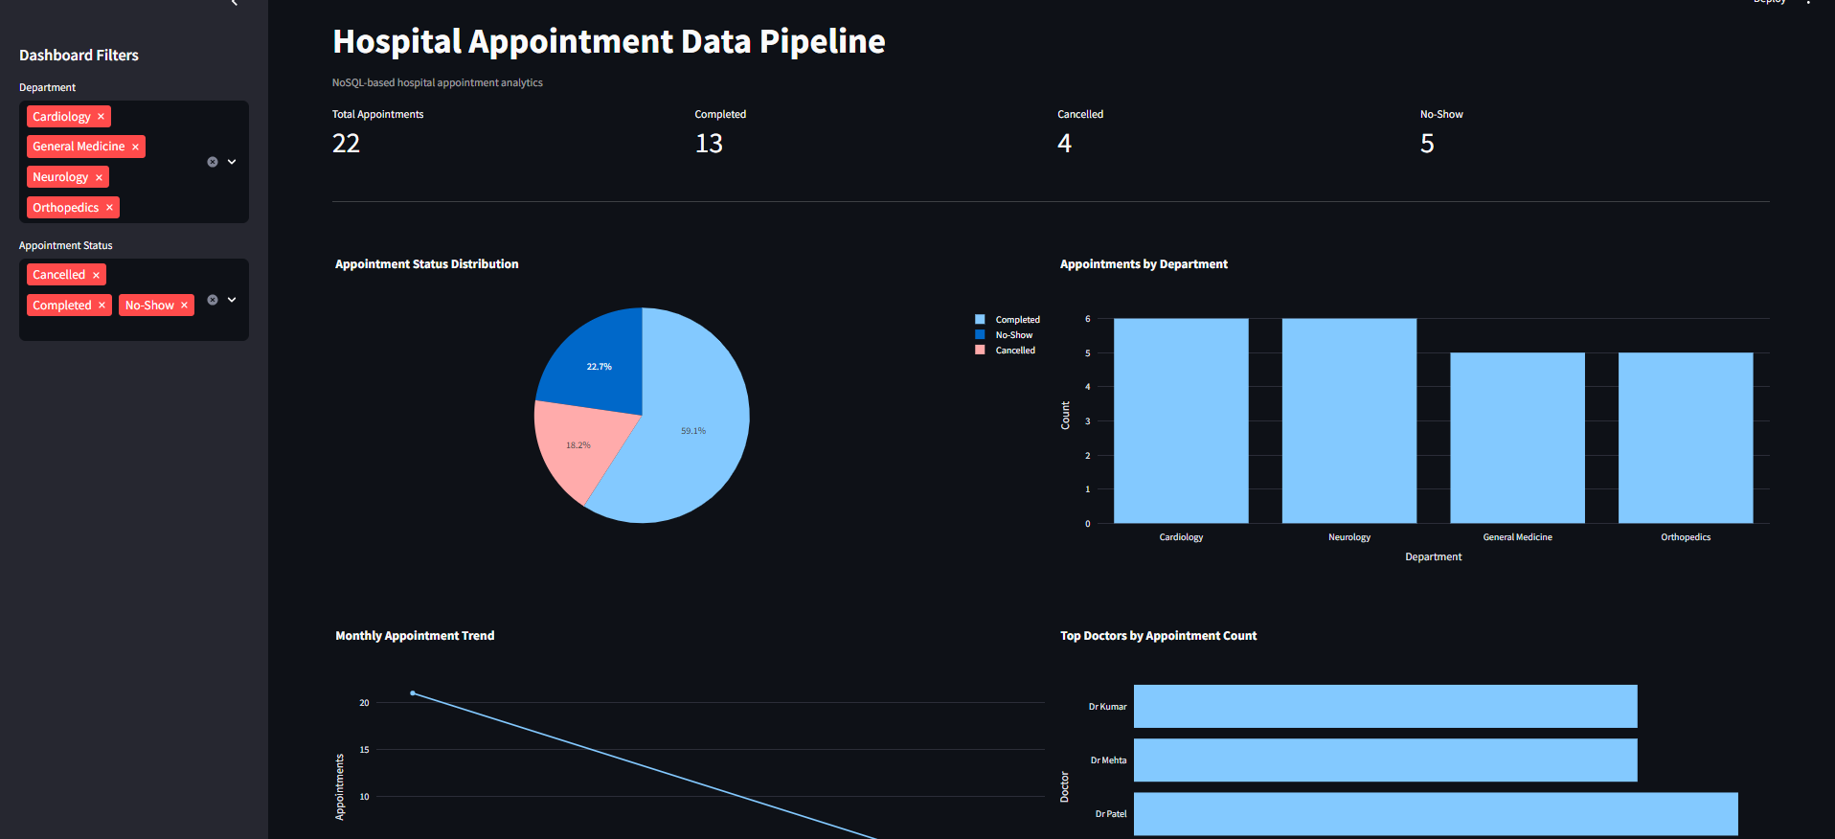
Streamlit dashboard for hospital appointment analysis

Slide 19
THANK YOU

